Slide 1
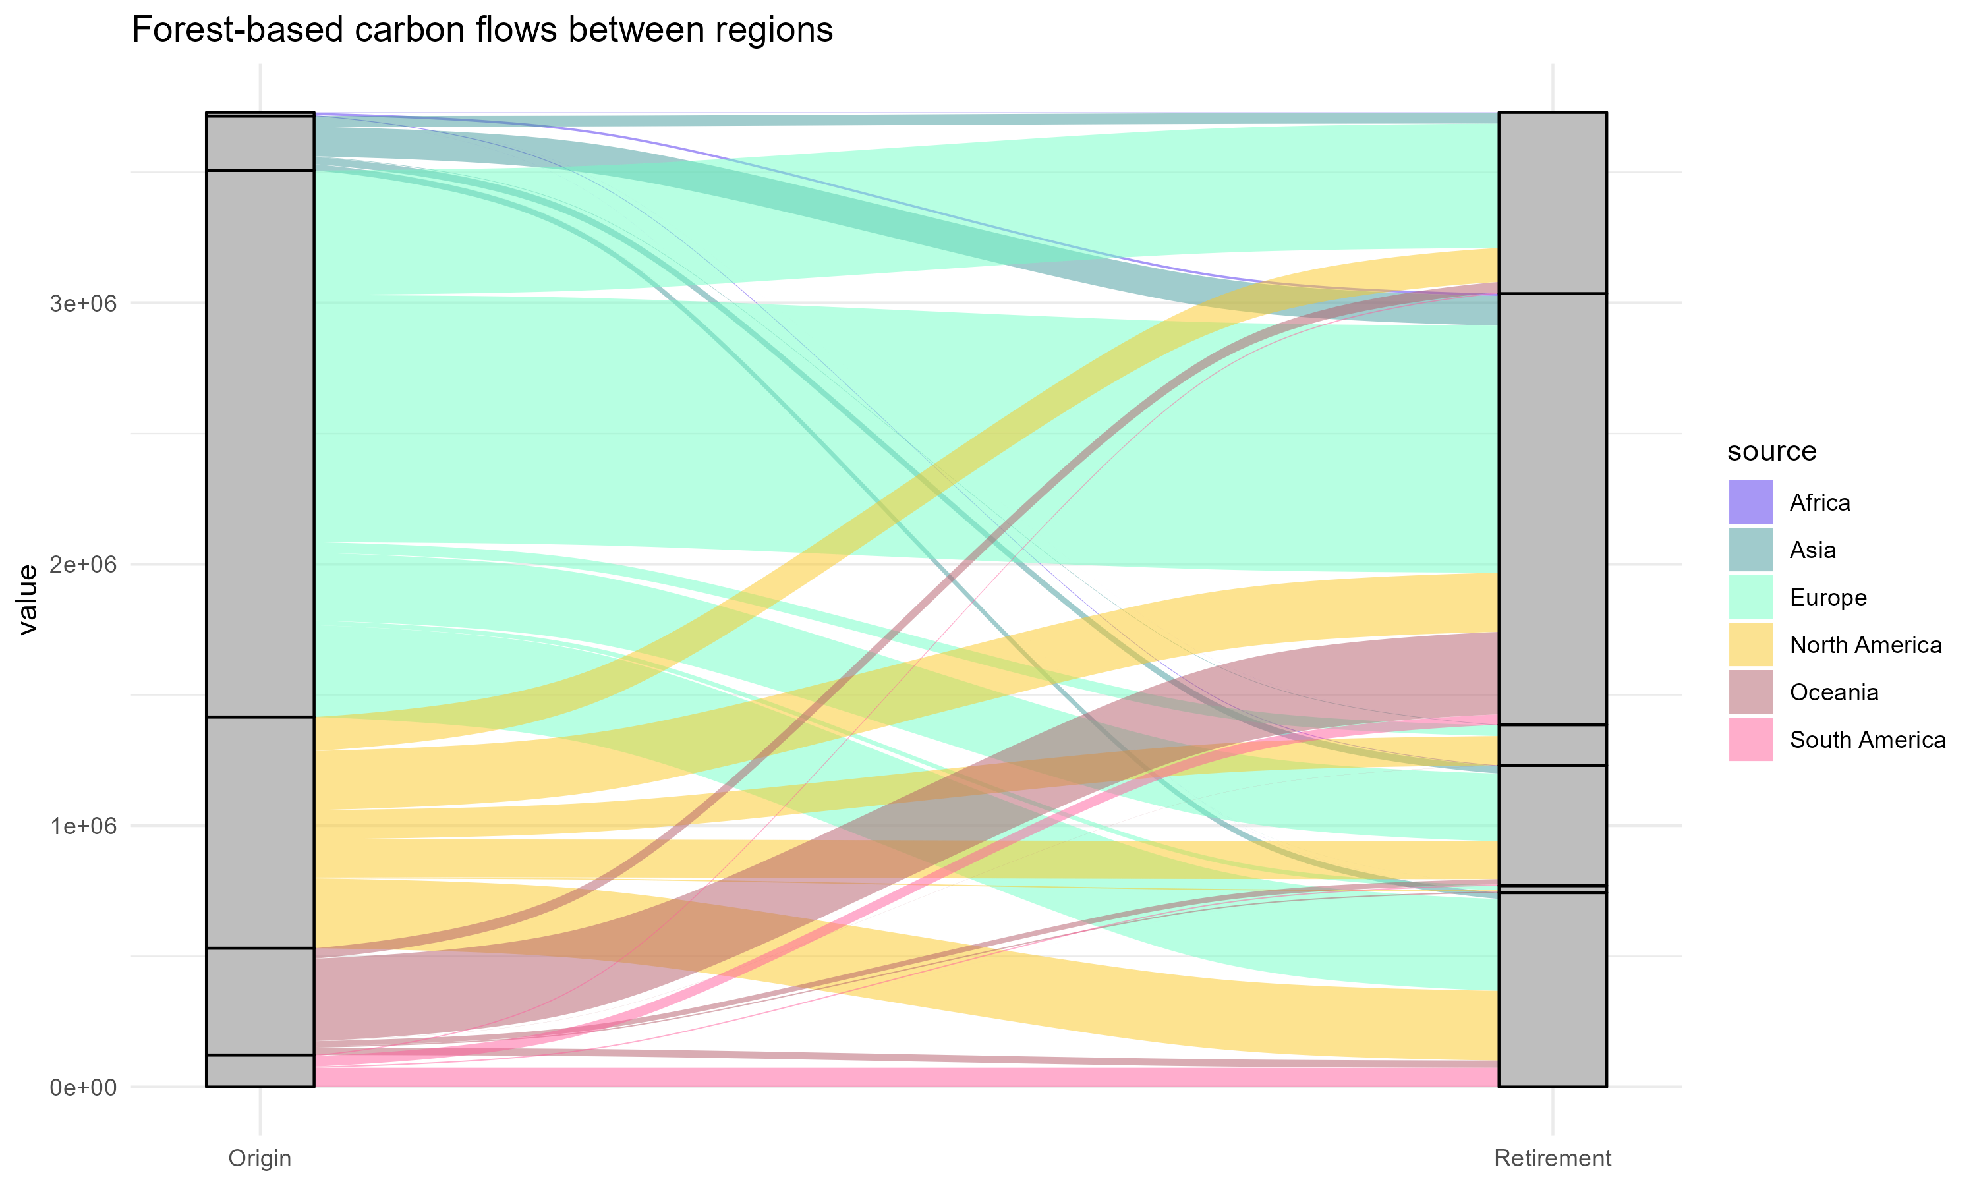
Africa
Asia
Africa
Europe
Asia
Tonnes of carbon
Europe
North America
North America
Oceania
Oceania
South America
South America

Slide 2
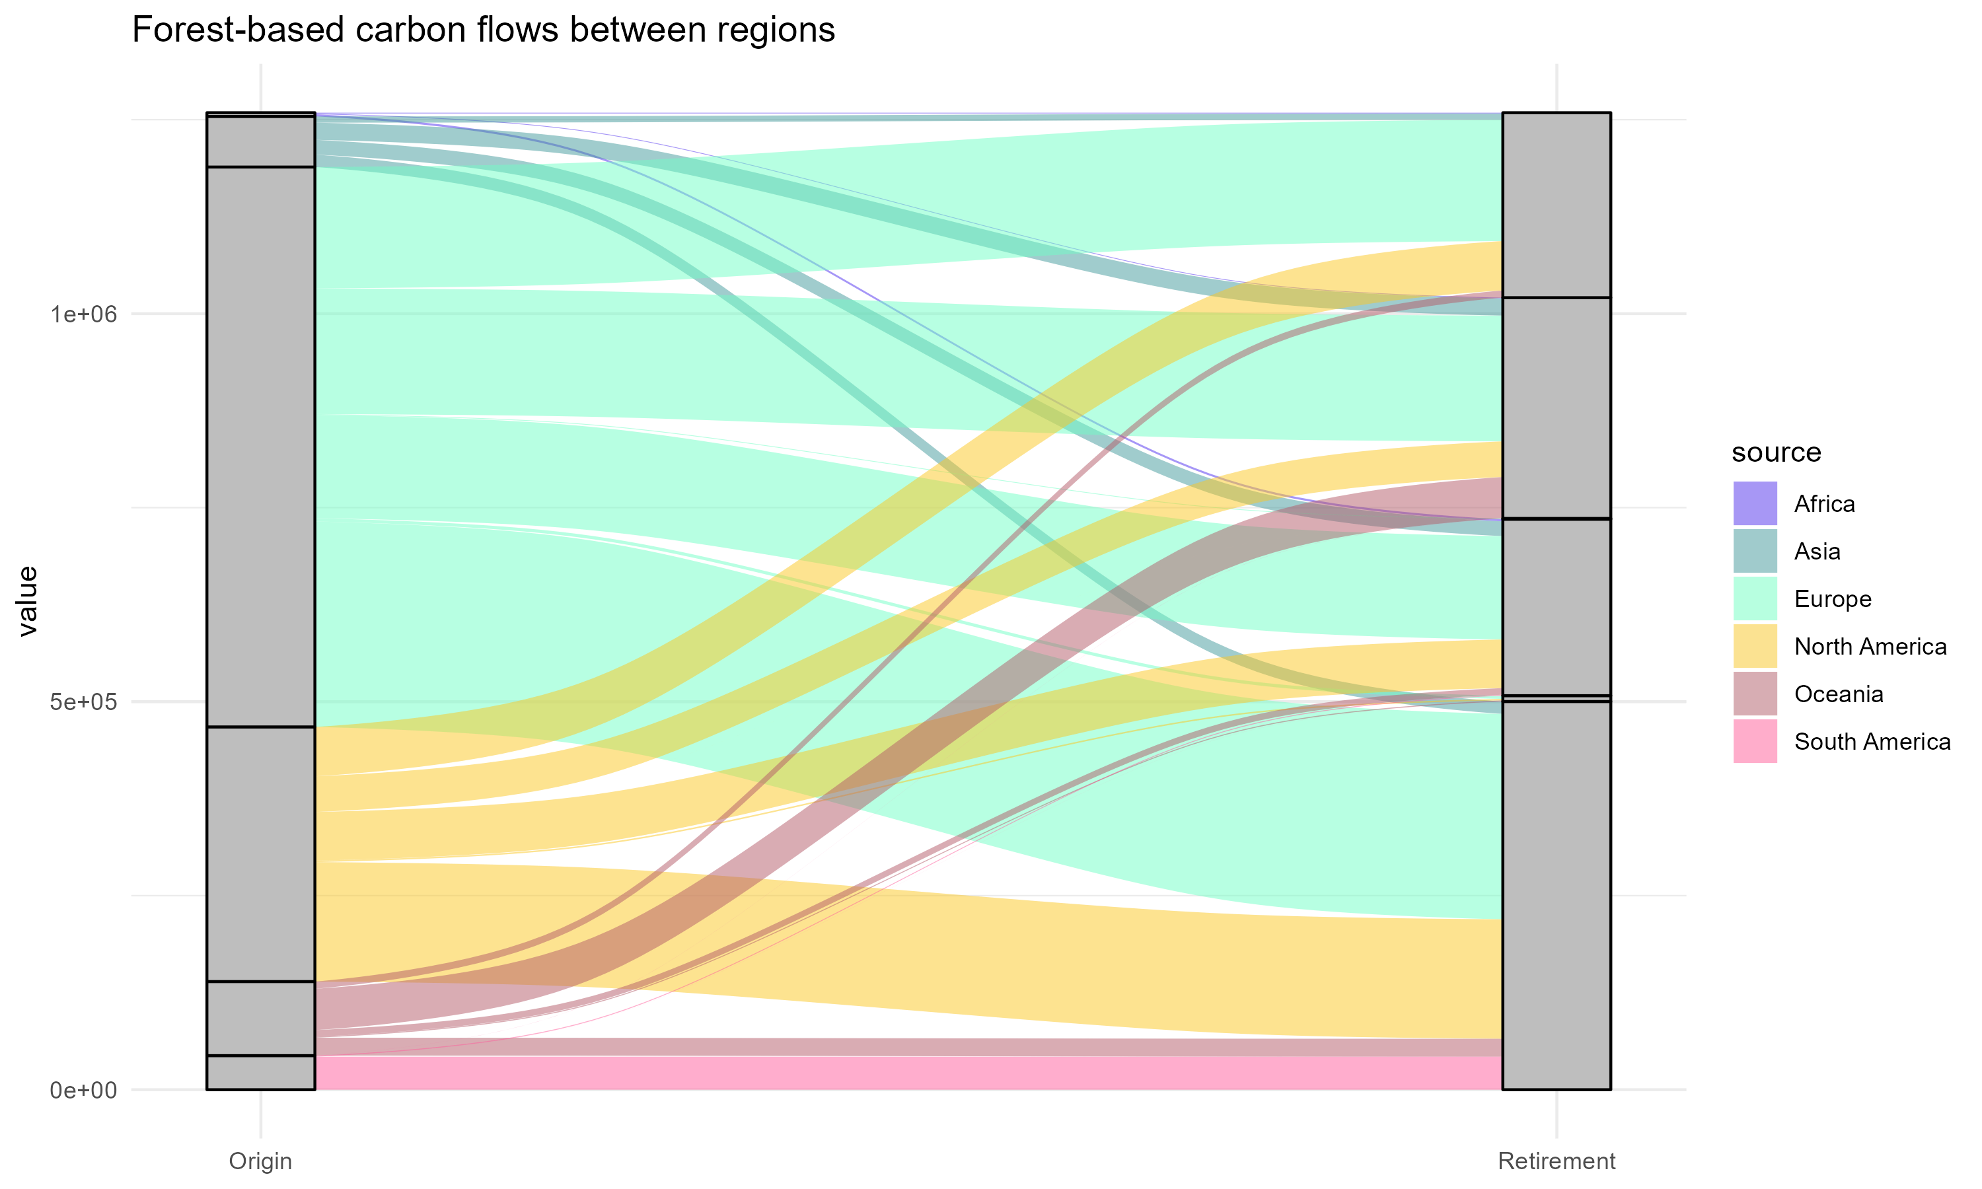
Africa
Asia
Africa
Asia
Europe
Europe
Tonnes of carbon
North America
Oceania
North America
South America
Oceania
South America

Slide 3
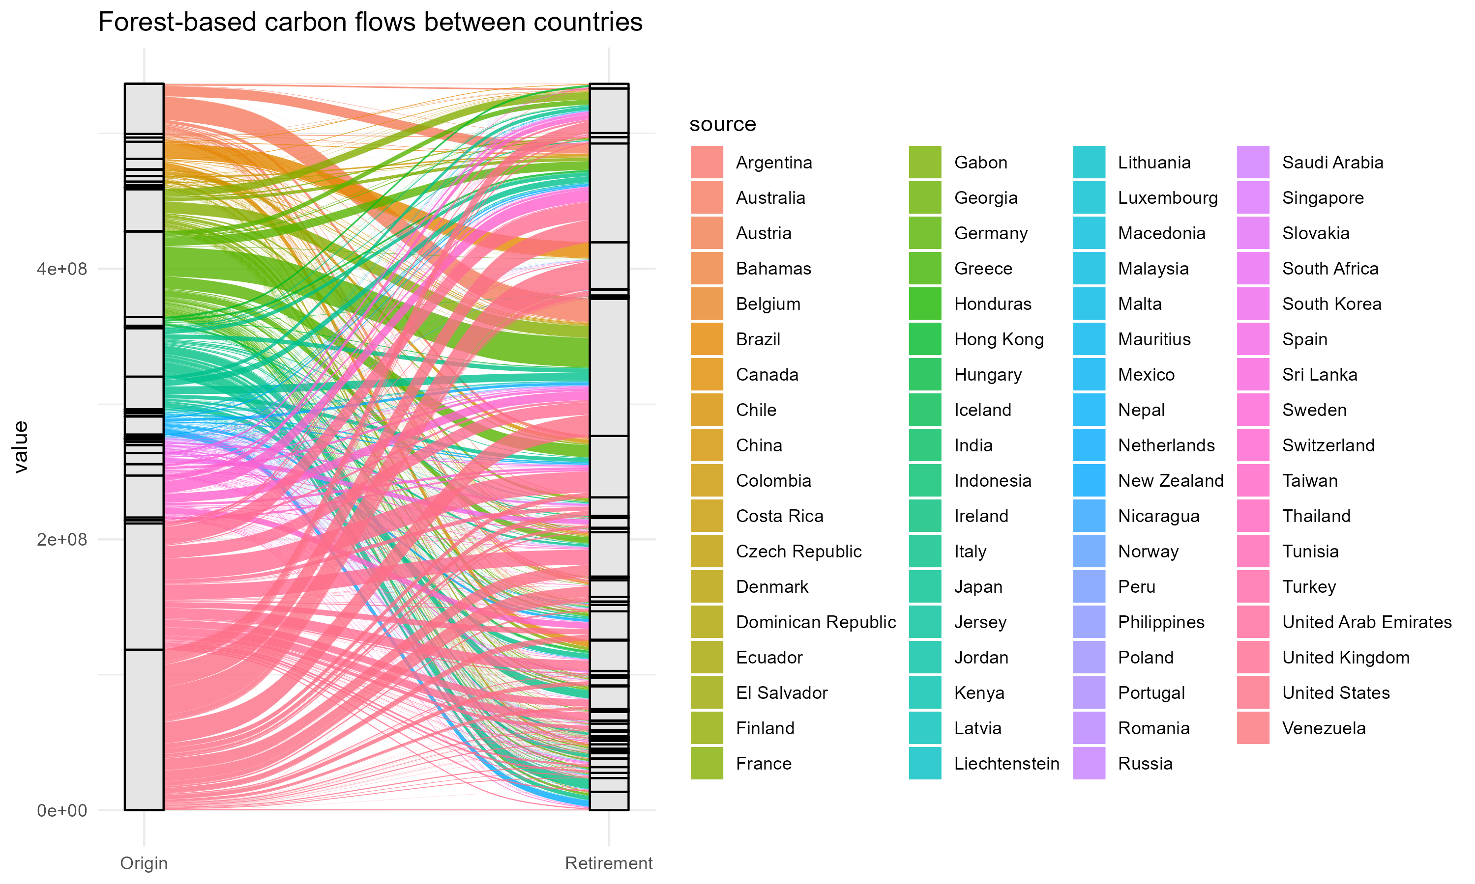
Australia
Brazil
Brazil
France
China
Colombia
Germany
Italy
India
Japan
Tonnes of carbon
Indonesia
Switzerland
Kenya
Peru
UK
South Korea
Turkey
UK
US
DRC
US
Uganda
Uganda
Zambia
Zimbabwe

Slide 4
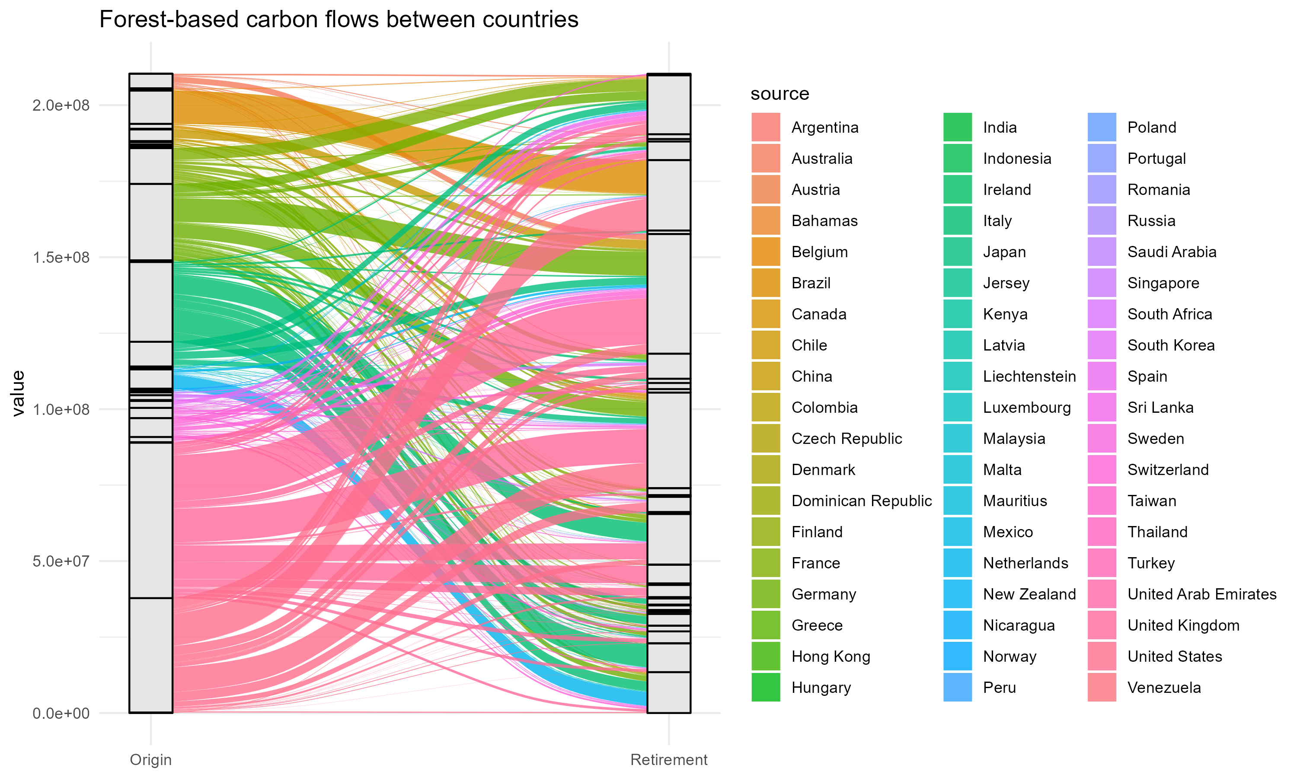
Australia
Brazil
Brazil
China
China
France
Colombia
Germany
India
Italy
Indonesia
Japan
Kenya
Netherlands
Tonnes of carbon
Switzerland
Peru
UK
DRC
Ethiopia
Guatemala
Tanzania
US
Zambia
Zimbabwe

Slide 5
